Slide 1
OODP
Introduction semester 2

Slide 2
Introduction - The second semester!
In Basecamp you learned the basics of programming and professional skills.
In this semester you will go into more depth: you will work together in a team on a complex product;
And you will further develop your professional skills, you will learn the concepts of object-oriented programming.

Slide 3
Introduction - Structure course
The course consists of two parts: Realisation and Professional skills. You will work on both parts as an individual and in a team context.
This means that you practice the theory of OODP (LAB) individually and then apply this in the project that you are working on as a team.
The professional skills are reflected in your attitude and behaviour, your role within the team and how you apply the scrum methodology as a team.

Slide 4
Introduction - Structure course
In Basecamp, you have learned to program in Python. In this semester, the programming language is C#.
In the first weeks, you will learn the basics of C# and the key differences between C# and Python.
You will also work on Project Alpha. This project is intended to experience:
-what it is like to work together on a project,
-to use the scrum methodology and
-to apply the first concepts of C# in a project.

Slide 5
Introduction - Structure course
After Project Alpha, the main project starts: develop a console application.
You will learn even more object-oriented (OO) concepts in LAB, which you can implement in this application.
In this semester it is not only about programming and developing the application: collaboration, testing and a professional attitude are also an important part of OODP.
The course is concluded with a digital exam (individual) and the delivery and presentation of the console application and the documents (team and individual assessment).

Slide 6
Introduction – Practical
- Two days on-site every week: 12 hours in total
- ± 500 unsupervised hours in total for selfstudy, making the assignments and working on the project and have team meetings
- Attendance is mandatory (Late counts as half absent)
- Every class consist of both parts: working individually on your theoretical knowledge and programming skills and as a team on the project.
- Two teachers
- 27 ECTS
-You’ll pass this semester if:
Your digital exam is at least graded 5.5, and
Project is at least 5.5 and
You meet the prerequisites

Slide 7
Overview - Evaluation
Professional skills and realisation
Evaluation on individual and team level
Four learning outcomes (next slides more info)

Slide 8
Learning outcomes – Professional skills
Team | Individual
You showed you are able to clarify the needs and wishes of the product owner. You are able to apply an agile project methodology. | You showed you are a professional team member by working on a product and adapting this according to the wishes and needs of a product owner. You are able to professionally present and demonstrate the product. You showed you can fulfill the role of scrum master with all the responsibilities. Furthermore, you showed a professional attitude (behaviour) with regard to student success.

Slide 9
Learning outcomes – Realisation
Team | Individual
You are able to develop a console-based application with paid attention to architecture and implementing OOP concepts in the application. You are able to improve the product through testing to validate the quality of the product. | You are able to translate class diagrams to code structures, apply the four fundamental principles of object-oriented programming in C# and the advanced concepts introduced in the second half of the course.

Slide 10
Student succes
Feedback conversations (Min. 1 per OP)
Selfevaluation
Peerevaluation
Interview with senior students
More information will follow

Slide 11
Overview semester 2 – important dates
Semester 2: 20 weeks
Week 1: Start
Week 9: Midterm exam
Week 17: Deadline project
week 18: Endterm exam
Week 20: Resit exam

Slide 12
Project Alpha
In the first weeks of practice you will start with project Alpha. Why?
To learn scrum
To get hands-on experience with C#
To get to know each other
After this experience you are ready to start with the main project

Slide 13
Needed to complete Project Alpha
Topics:
Tools / methodology
Primitive types
Console input/output
Selection
Loops
Methods
Classes
Lists
Static
Scrum
Github
Team
OODP

Slide 14
Project Alpha – The case
Objective
Hands-on experience with
Scrum
C#
Git
Working in a team
Company Sharkshark
Wants a simple role playing game (RPG)
Must-haves
Made with C#
Using scrum
Should have
Game contains 9 locations
Userfriendly
Practical
3 week project
Team project 4 / 5 students

Slide 15
The game - introduction
The people in your town are being terrorized by giant spiders. You decide to do what you can to help.
Objective: complete all quests

Slide 16
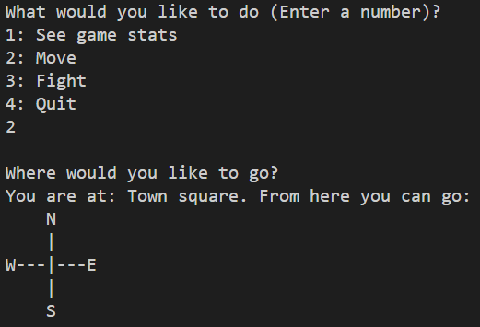
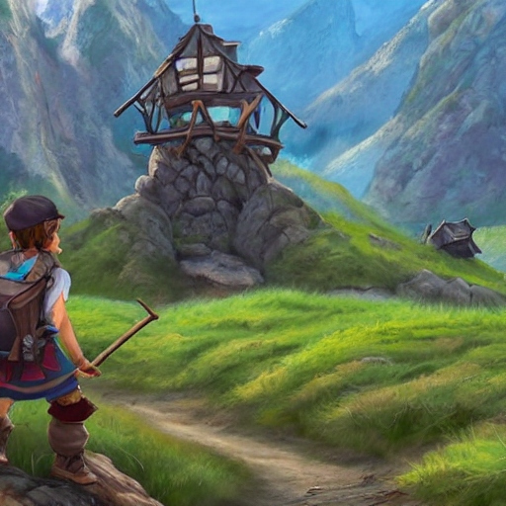
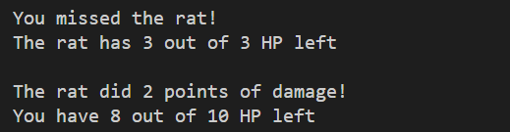
Simple RPG (Role playing game)
Notes:
Hero

Slide 17
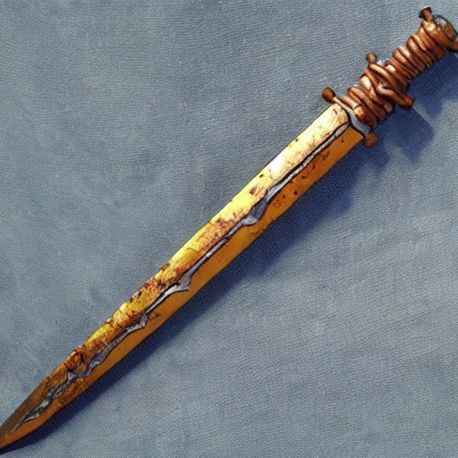
The Hero
You start off with a rusty sword
Serviceable, but perhaps you could find a better weapon?

Slide 18
The game – Legend and map
H: Your house (game start)
T: Town square
F: Farmer
V: Farmer’s field
A: Alchemist’s hut
P: Alchemist’s garden
G: Guard post
B: Bridge
S: Spider forest
|
|
--+---
|
P
A
VFTGBS
H

Slide 19

Quest: Clear the farmer’s field
P
A
VFTGBS
H
Given by Farmer (F)
Kill snakes in the farmer’s field (V)
Killing three snakes will complete the quest
“I can't w'rk mine own landeth with those pesky snakes slith'ring 'round! Shall thee holp me?”

Slide 20
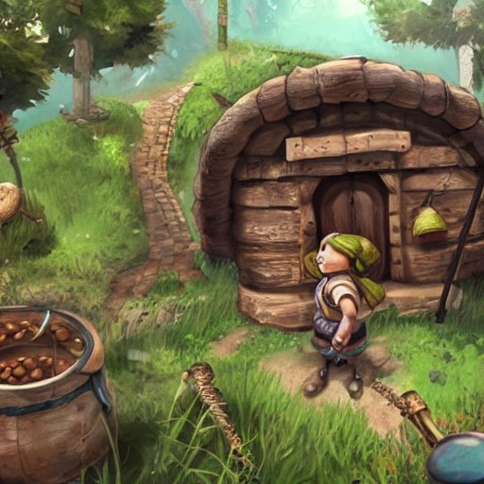
Quest: Clear the alchemist’s garden
P
A
VFTGBS
H
Given by Alchemist (A)
Kill rats in the alchemist’s garden (P)
Killing three rats will complete the quest
“Those rats art nibbling on mine own h'rbs! I couldst very much useth an adventur'r to taketh careth of those folk …”

Slide 21
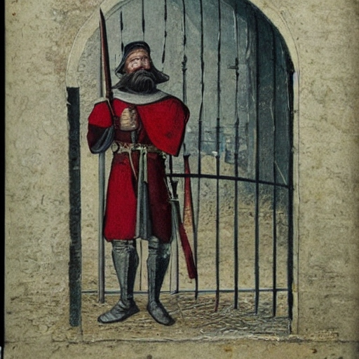
Guard’s post
P
A
VFTGBS
H
You need to have finished the other two
quests before passing the guard (G)
“Turn back at once, peasant! Unless thee hast proof of thy grit.”

Slide 22

Quest: Collect spider silk
P
A
VFTGBS
H
Received when reaching the bridge (B)
Kill spiders in the spider forest (S)
The game is won when you have killed three spiders
“I shalt releaseth the town folks of their feareth!”

Slide 23
Scope
Must be built in C# (.NET 8)
Must be console-based
GitHub must be used
Scrum must be used
VSCode/VS must be used
World.cs must be used as a code base
(Feel free to edit World.cs to your needs)
Must be built using OODP

Slide 24
Documents
Codebase will be shared
World.cs is used to create:
  Locations
  Monsters
  Weapons
  Quests
Product backlog will be shared

Slide 25
Global overview deadlines and meetings
Week 1:
(this week) Introduction Course, Case and Scrum
Git workshop, Project Alpha kick-off
Product backlog introduction (What and how)
Week 2:
Day 1: Working on project, Product Backlog (How) How to write a user story and acceptance criteria and Planning poker
Day 2: Pre planning meeting and stand up.
Week 3:
Day 1: Stand up, Workshop: review + retrospective.
Day 3: Project Alpha review and retrospective

Slide 26

Embark on thy quest, adventur'r!
All illustrations created using deepai.org

Slide 27
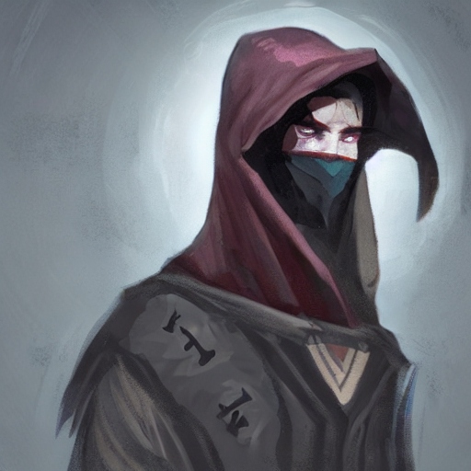
Questions?
The dungeon master shall provide thou with answers

